Slide 1

Malignant Comments Classification
Internet comments are bastions of hatred and vitriol. This can take a toll on anyone and affect them mentally leading to depression, mental illness, self-hatred and suicidal thoughts. Our goal is to build a prototype of online hate and abuse comment classifier which can used to classify hate and offensive comments so that it can be controlled and restricted from spreading hatred and cyber bullying.
FLIP ROBO REMOTE INTERNSHIP
Developed By:
Deepam Purkayastha

Slide 2
Problem Statement:
The proliferation of social media enables people to express their opinions widely online. However, at the same time, this has resulted in the emergence of conflict and hate, making online environments uninviting for users. Although researchers have found that hate is a problem across multiple platforms, there is a lack of models for online hate detection. Online hate, described as abusive language, aggression, cyberbullying, hatefulness and many others has been identified as a major threat on online social media platforms. Social media platforms are the most prominent grounds for such toxic behaviour. This can take a toll on anyone and affect them mentally leading to depression, mental illness, self-hatred and suicidal thoughts.
Objective:
Internet comments are bastions of hatred and vitriol. While online anonymity has provided a new outlet for aggression and hate speech, machine learning can be used to fight it. The problem we sought to solve was the tagging of internet comments that are aggressive towards other users. Our goal is to build a prototype of online hate and abuse comment classifier which can used to classify hate and offensive comments so that it can be controlled and restricted from spreading hatred and cyber bullying.

Slide 3
Data analysis to model building flowchart
Import Libraries
Dataset Collection
Data preprocessing
NLTK(For Text analysis)
EDA
Checking Null Values
Checked for co-relation
Checked for Outliers/Skewness(if required)
Proceed for Model building(Train/Test)
Saving the Model
Hyper Parameter Tuning(if required)
Accuracy, confusion matrix, classification report,CV Score, AUC-ROC

Slide 4
Data Pre-processing Done
Importing Libraries.
Read the CSV file and convert into data frame.
Checking the data dimensions for the original dataset.
Looking for null values if any, in heat map. & accordingly fill the Nans.
Checking the summary of the dataset.
Checking unique values.
Converted the comments in train data into lowercase
Visualizing each features using matplotlib and Seaborn.
Have removed punctuations, stop words to get a clean length.
Replaced all the comments text with required data format for both train & test data set.
Checked for all the offensive loud words using word cloud.
Checked the distribution of label over comments by using pie plot.
Have converted text into vectors using TF-IDF for model building.
Original Length of training set before cleaning: 62893130 & Original Length of Test set before cleaning: 55885733
Created train test split: We have split the train & test data in 0.30 test size with random state 56.

Slide 5
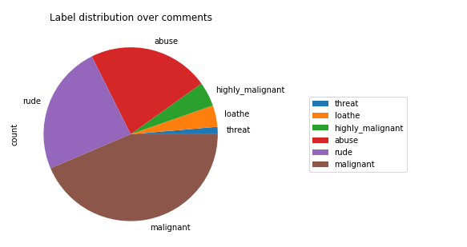
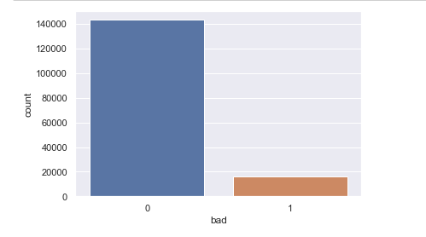
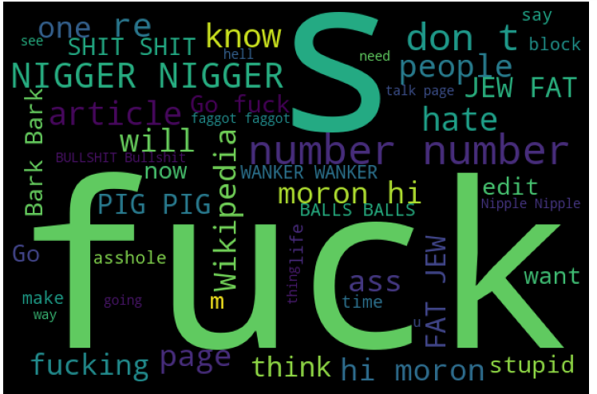
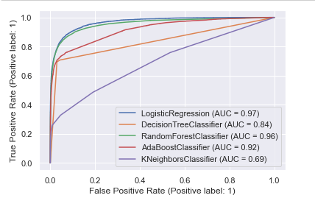
Exploratory Data Analysis through Visualizations
Count plot, pie plot, & word cloud plot helped me to understand the distribution of comments, loud words & the count of bad words.
ROC-AUC: Helped me to understand & select the best model out of 5 models based on ROC-AUC score.
Visualizations: It helped me to understand the correlation between independent & dependent features. I got to know the count of particular category for each features by using count plot & most importantly AUC-ROC helped me to select the best model.

Slide 6
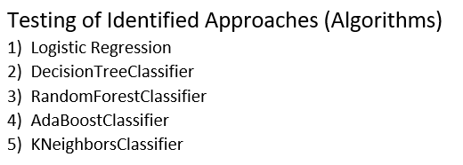
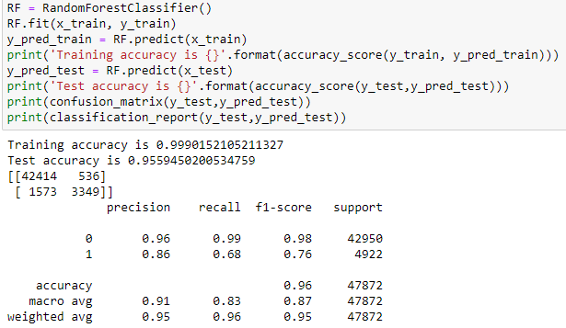

Model/s Development and Evaluation :
I have performed multiple algorithms to get the best model, and found out Random Forest Classification is the best fit model out of all the other algorithms based on the metrics such as accuracy score, confusion matrix, the classification report (Precision, recall & f1-score), Cross validation Score, & AUC-ROC as shown in this slide.

Slide 7
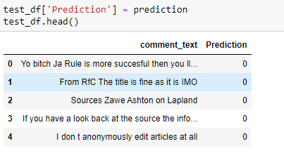
Conclusion
After performing the model building, I have got the highest score for RandomForestClassifier with 96% accuracy score having less Type-I &II error as compared to other models but it could be due to overfitting, so I have checked for the cross validation scores & found 95% score, which gives very less difference between accuracy score & CV score. Hence, based on accuracy score, confusion matrix, the classification report (Precision, recall & f1-score), Cross validation Score, and AUC-ROC, I have got the best fit model is RandomForestClassifier.

Slide 8
Thank you

